Slide 1


A PRESENTATION
ON
STUDENTS INDUSTRIAL WORK EXPERIENCE SCHEME
(SIWES)
BY
CHUWKUEMEKA-EZEH, ESTHER CHINENYE
21010306008

Slide 2
Outline
Brief overview of the company
Units in the department
Work done in the department
Data Analysis & its Techniques
Data Entry
Data cleaning and sorting
Data visualization
Data export and sharing
Experience gained
Conclusion

Slide 3
Brief overview of the company
The Rivers State Information and Communication Technology (ICT) was established in the year 2008 by the former Governor of Rivers State, Rt. Hon. Chibuike Rotimi Amaechi. During this regime, Mr. Good Leaf Mekini was appointed as the State Special Adviser (SSA) on ICT.
The primary function of this department is to automate major governmental processes including; the recruitment of staff, storing of state (Ministries Departments Agencies, MDA’s) records, biometrics, verification of staff and pensioners, and training of Rivers State residents on the use of ICT gadgets.
This department handles communication between the different MDAs using an enterprise network. Also, they are solely responsible for the development and maintenance of other MDA's websites.

Slide 4
Units in the department
RIV Tech Creek
Research department
Training centre
Database team
Web application
Network Infrastructure
Data centre
Help desk
Admin
Project department
Finance department

Slide 5
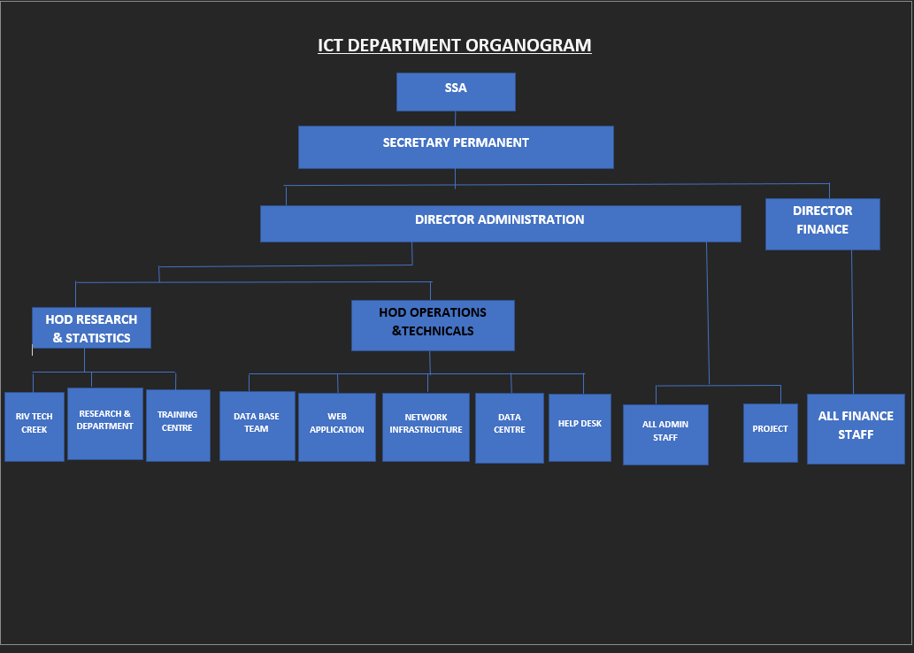
Units in the department Con’t

Slide 6
Work done
The nature of work undertaken ranges from the implementation of the Rivers State Public Service Management Information System (RIVPUSMIS), network diagnosis and troubleshooting to data analysis to improve decision making and automate processes in the organization.
I worked with the Biometrics sub-unit under the Admin unit to assist in the implementation of the Rivers State Public Service Management Information System (RIVPUSMIS). At the Network Infrastructure unit, I assisted in trouble shooting the systems and performed different network diagnosis to reduce downtime on the network. At the RIV Tech Creek, I learnt data analysis to optimize and improve the Company’s processes and decisions.

Slide 7
Data analysis & its techniques
Data analysis involves the systematic inspection, cleansing, transformation, and interpretation of data to discover meaningful patterns, draw conclusions, and support decision-making. This process employs a range of techniques to convert raw data into valuable insights.
By scrutinising data using various tools and methodologies, data analysts can identify trends, relationships, and anomalies, leading to informed decision-making. These insights help organisations optimise processes, enhance customer experiences, and make predictions for future actions based on past data patterns.
During my SIWES period, I worked with Google colaboratory, and Microsoft Excel to perform different data analysis techniques including;
Data Entry
Data Cleaning & Sorting
Data Visualization
Data Export and Sharing

Slide 8
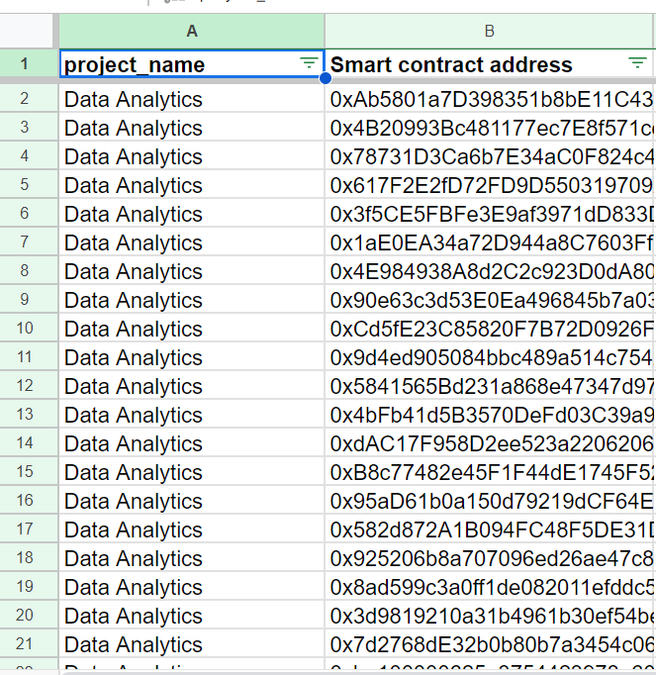
Data Entry
Data entry refers to manually entering information into a computer database or spreadsheet.
In Microsoft Excel, I efficiently entered data into well-structured columns and rows using its user-friendly interface. I ensured data accuracy and consistency through tools like data validation and cell formatting. Any errors or inconsistencies were promptly corrected to preserve data integrity and interpretability for future analysis.

Slide 9
Data cleaning and sorting
Data cleaning is the process of identifying, correcting, and transforming raw data into consistent, accurate, and reliable information. Data sorting is the process of arranging data in a specific order, making it easier to analyze, visualize and understand. The primary goal of data cleaning and sorting is to remove errors and inconsistencies to improve data accuracy. In Microsoft Excel, I created structured datasets that greatly enhanced the clarity of information.

Slide 10
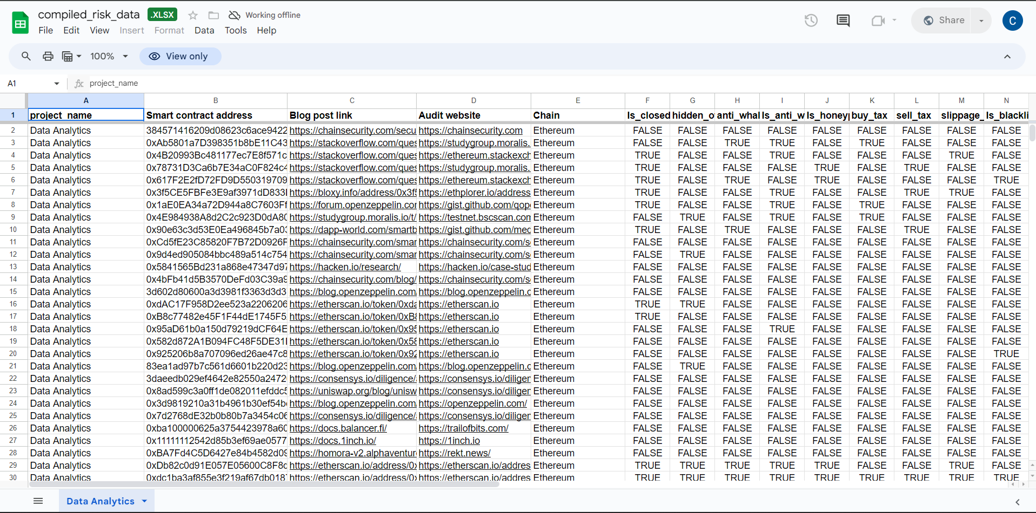
Data Cleaning and sorting con’t

Slide 11
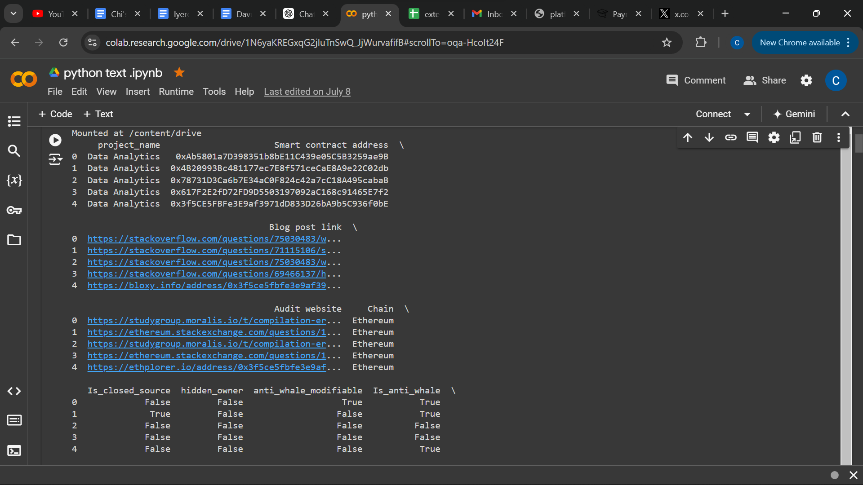
Data Cleaning and sorting con’t
Sorting data within Google Colaboratory ensured the visualisations: bar charts and scatter plots effectively communicated insights. For instance, it sorted the smart contract addresses by occurrence to make it easier for the stakeholders to identify trends and make data-driven decisions.

Slide 12
Data Visualization
Data visualization is the representation of data in a visual format such as charts, graphs, maps, and infographics.
The primary goal of data visualization is to communicate insights and patterns in data effectively, enabling faster and more informed decision-making.
Excel offers various chart types, including bar charts, line graphs, pie charts, and scatter plots, which I skillfully utilized to represent data visually.

Slide 13
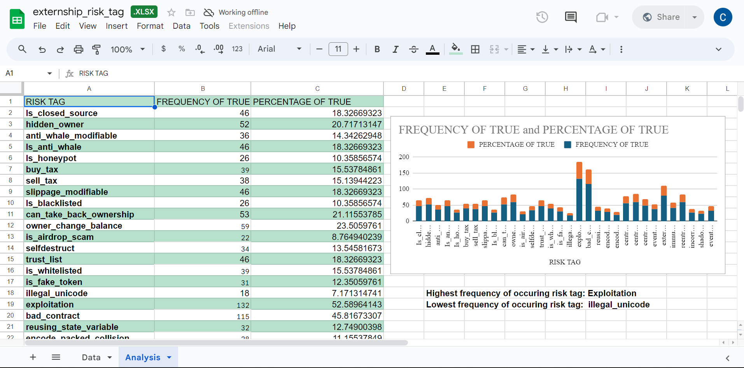
Data Visualization con’t

Slide 14
Data Visualization con’t
Using Google Colaboratory, with its rich visualization capabilities, enabled me to design interactive and dynamic charts. These dashboards provide stakeholders with a comprehensive view of complex datasets. To achieve this, I used some of Google Colaboratory's visualization features, such as Matplotlib, seaborn and, plotly.
During my SIWES period, I harnessed its visualization capabilities to design charts to examine the correlation between each risk tag occurrence.

Slide 15
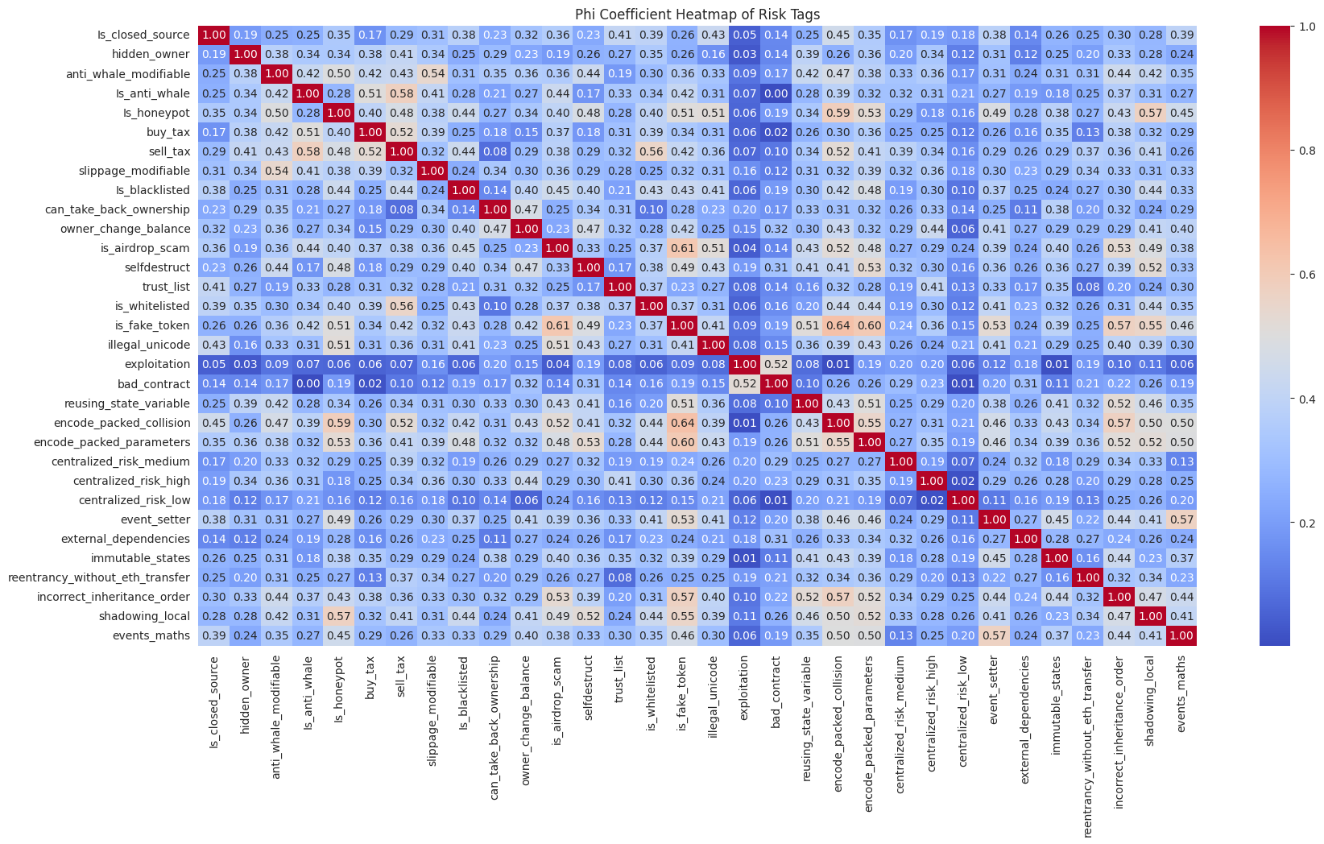
Data visualization con’t

Slide 16
Data Export and sharing
Data export and sharing is an essential aspect of data analysis and collaboration to enable data to move between different tools and environments and share it with others for various purposes. This is to ensure the data is accessible, understandable, and secure for the intended audience.
Excel offers versatile options for exporting data, making it accessible to a wider audience. I frequently utilized the "Save As" feature to export worksheets or selected data ranges into various formats such as PDF(Portable Document Format), CSV(Comma- Separated Values), or even Excel (i.e. XLS, XLSX ) files.
Google Colaboratory enhances data sharing through interactive and dynamic visualization. I created notebooks for the report and made them accessible to authorized users. Through the integration of this notebook with Google Drive, version control was provided enabling stakeholders to interact with data visualizations, fostering data-driven decisions.

Slide 17
Experience gained
During my SIWES program at the Rivers State ICT department, I gained a diverse set of skills in network diagnostics, management information system implementation and data analysis.
In network diagnostics, I learned several troubleshooting methodologies, network architecture understanding, device configuration and packet analysis using tools like Wireshark and traceroute. I used this skill to identify and resolve network issues and packet delivery errors.
In Management Information System Implementation, I learned database management and administration of the organization, RIVPUSMIS. I used this skill to automate their retiring and recruitment process.
In data analysis, I learned to systematically inspect, clean, transform, and interpret data using tools like Microsoft Excel, and Google Colaboratory. These skills enabled me to draw meaningful insights from data, optimize processes, and support decision-making.
Also during my leisure period, i acquired various online certifications like Introduction to Linux on Cisco, Python programming on Solo learn and others.
These experiences equipped me with exposure to different technological tools.

Slide 18
Conclusion
Overall, my SIWES internship provided me with a comprehensive skill set spanning network diagnostics, management information system implementation, and data analysis, enhancing my proficiency in software development.

